Slide 1

Introduction to Data Visualization

Slide 2
Learning Objectives
By the end of this session, you will be able to:
Understand the importance of data visualization.
Understand the various visualization techniques.
Learn how to create and interpret the various plots in Python.

Slide 3
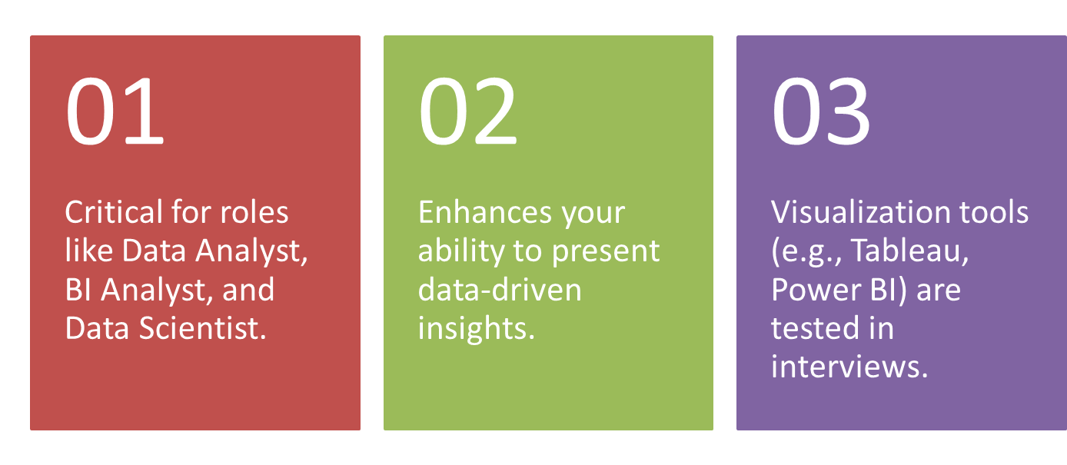
Why Visualization Skills Matter in Careers?

Slide 4
Data Visualization in Decision-Making
Helps stakeholders understand trends and patterns quickly.
Increases the impact of presentations and reports.
Critical for strategy formulation and operational insights.

Slide 5
How does Data Visualization help?
Transforms raw data into clear, actionable insights.
Enhances decision-making by making patterns easier to detect.
Key for storytelling and communicating findings effectively.

Slide 6
Common Visualization Techniques
Line Charts: Best for tracking data over time (e.g., COVID cases).
Bar Charts: Effective for comparing categories.
Pie Charts: Visualizing part-to-whole relationships.
Scatter Plots: Showing relationships between variables.
Heat Maps: Visualizing density or intensity of data.

Slide 7
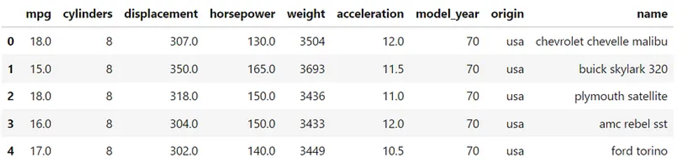
Python Implementation
‘mpg’ dataset in seaborn
You are a data scientist working at car sales outlet and you have been asked to perform EDA using visualization on the data….

Slide 8
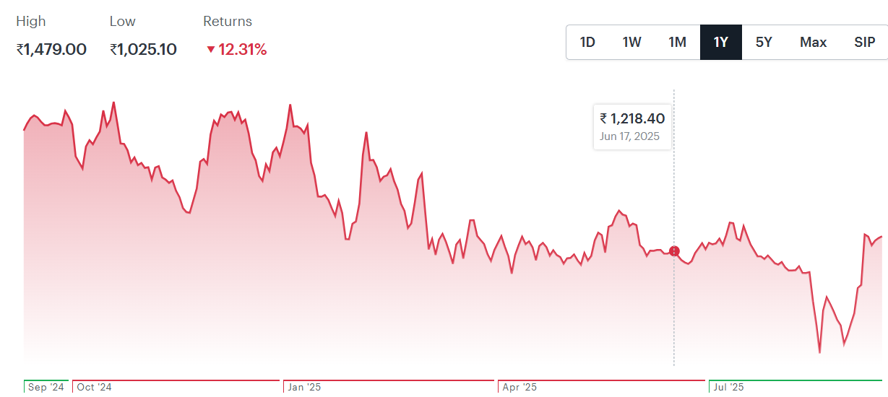
Line Chart Example: Stock Price of Bata India as on Sep 9

Slide 9
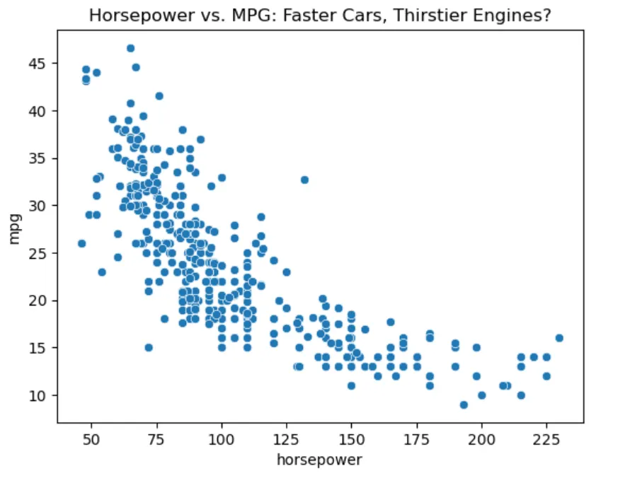
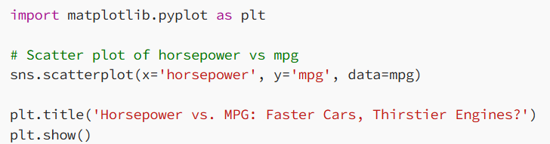
Scatter Plot Example

Slide 10
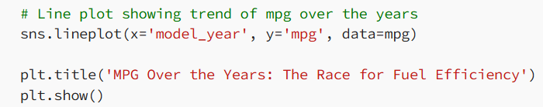
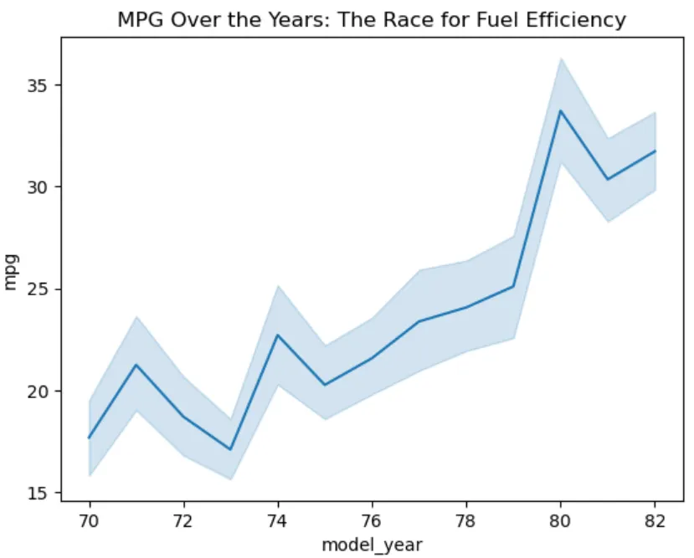
Line Plot Example

Slide 11
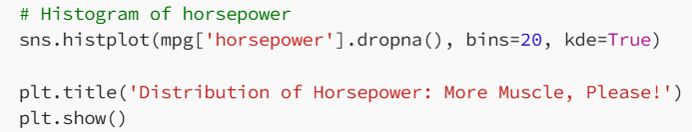
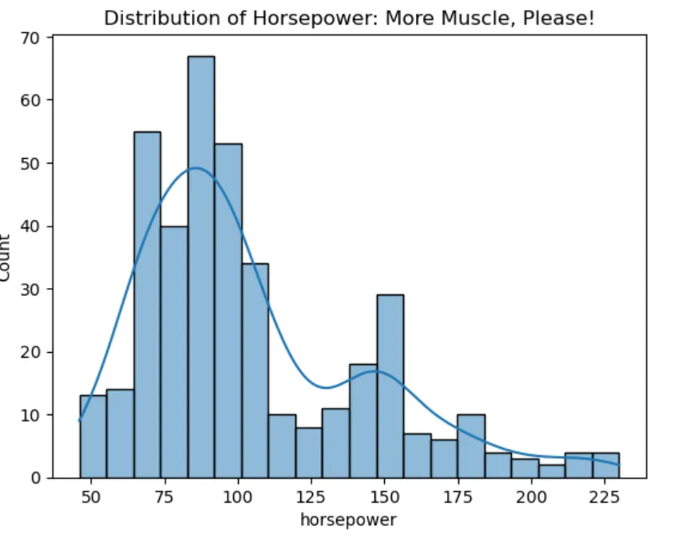
Histogram

Slide 12
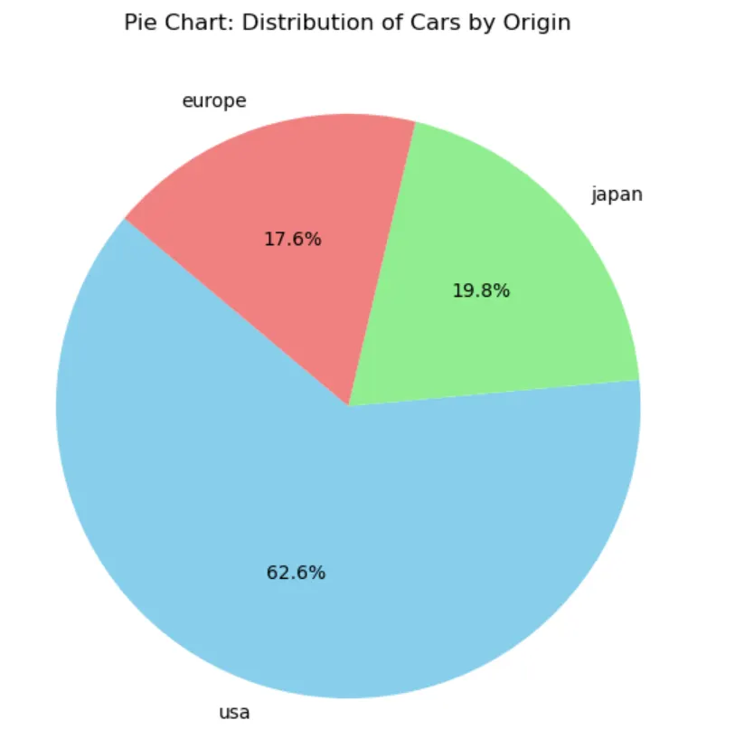
Pie Chart: Part-to-Whole

Slide 13
Pie Chart: Part-to-Whole
# Pie chart for car origins origin_counts = mpg['origin'].value_counts() # Plotting the pie chart plt.figure(figsize=(7,7)) plt.pie(origin_counts, labels=origin_counts.index, autopct='%1.1f%%', startangle=140, colors=['skyblue', 'lightgreen', 'lightcoral']) plt.title('Pie Chart: Distribution of Cars by Origin') plt.show()

Slide 14
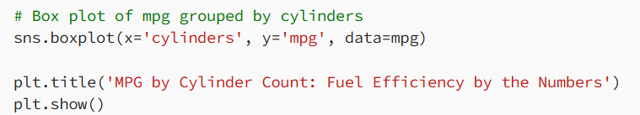
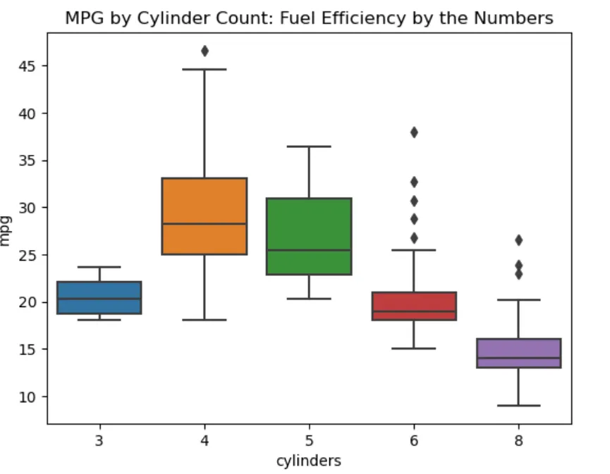
Box Plot

Slide 15
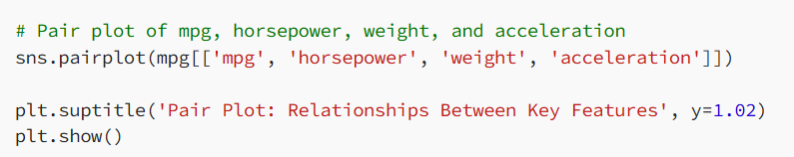
Pair Plot
If you want to visualize how multiple variables relate to each other, pair plot is a great way to do that.
So, this is an example of multi-variate (many-variables) visualization plot.

Slide 16
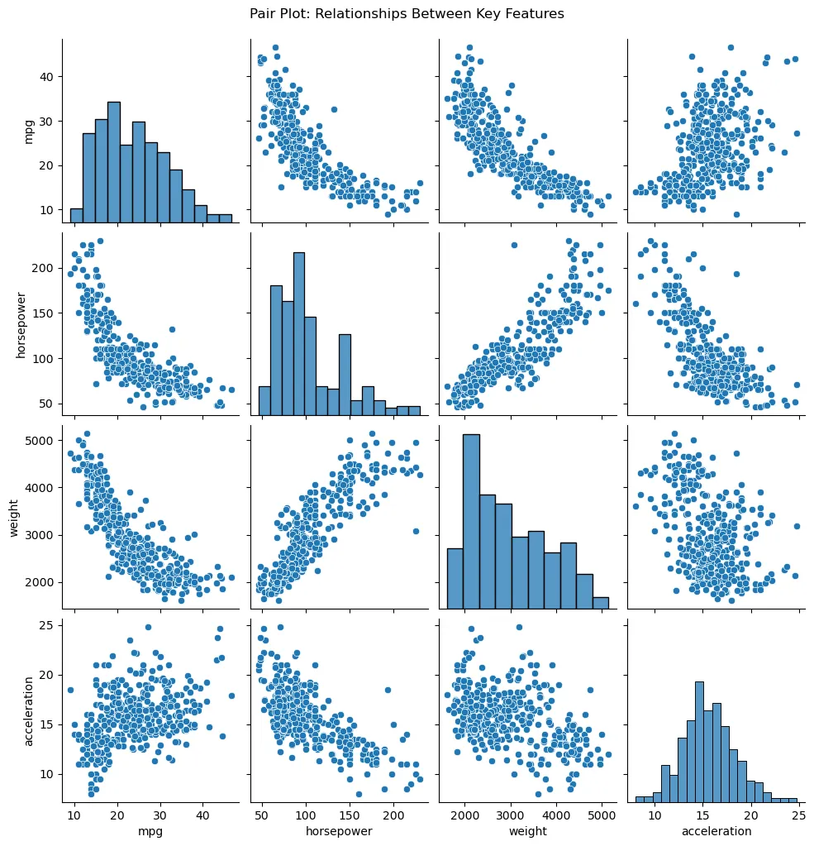

Slide 17
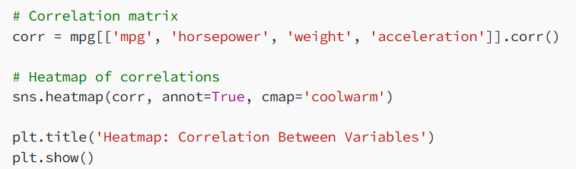
Heatmap
If you want to visualize correlation between multiple variables

Slide 18
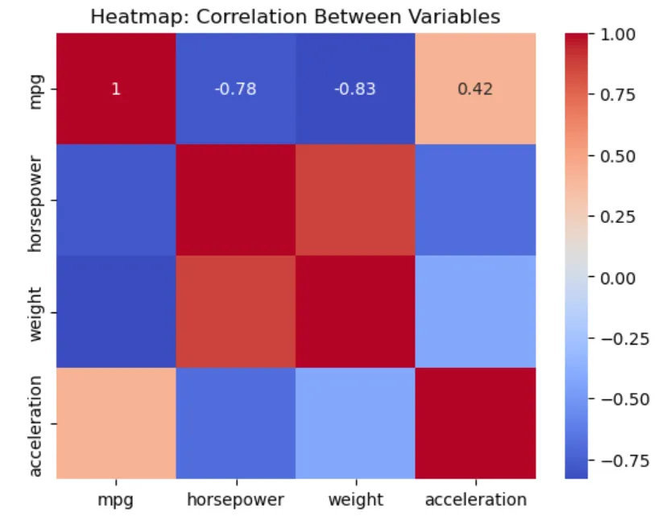

Slide 19
Stacked Bar Plot
A stacked bar plot shows how different categories stack up on top of each other.
# Pivot table for the stacked bar plot stacked_data = mpg.pivot_table(index='origin', columns='cylinders', aggfunc='size', fill_value=0) # Plotting the stacked bar plot stacked_data.plot(kind='bar', stacked=True) plt.title('Stacked Bar Plot: Cylinder Count by Origin') plt.xlabel('Origin') plt.ylabel('Count of Cars') plt.legend(title='Cylinders') plt.show()

Slide 20
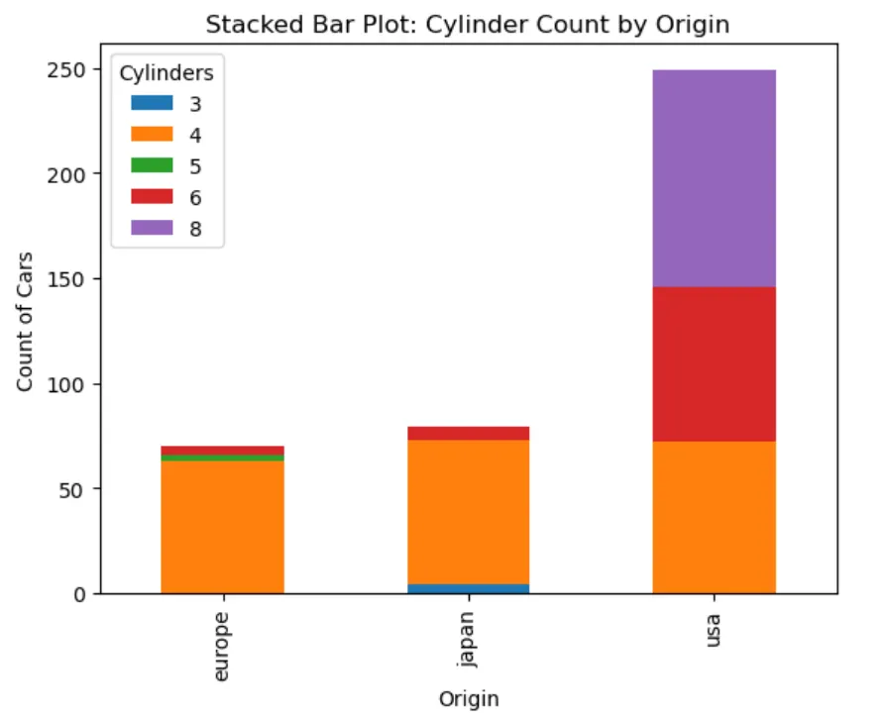

Slide 21
How to Choose the Right Visualization
Identify the type of data you are working with.
1
Understand the audience and the message you want to convey.
2
Choose charts that simplify complex data.
3
Avoid over-complicating with too many visual elements.
4

Slide 22
Multiple Choice Questions (MCQs)
1. A data scientist wants to show the monthly trend of website traffic over a year. Which visualization is most appropriate?
A. Scatter Plot B. Line Chart C. Pie Chart D. Bar Plot
2. A researcher wants to examine the relationship between students’ study hours and their exam scores. Which visualization should be used?
A. Pie Chart B. Line Chart C. Scatter Plot D. Bar Plot

Slide 23
Sample Questions
Sample Questions:
"How would you approach visualizing sales performance across regions?“
"Can you explain a time when a visualization led to actionable business insights?"
Hint: Practice explaining your thought process in both technical and business terms.

Slide 24
Session Summary
In this session, we have discussed about:
The importance of visualization from career as well as business perspectives.
The various visualization techniques and when to us each one of these.
How to create and interpret the various plots in Python.

Slide 25
Reference Links
How to Create Stunning Data Visualizations in Python: Top 10 Techniques to Learn
Why your visualizations look basic?
Mastering Credit Risk Analysis: A Step-by-Step Guide to Descriptive Statistics in Python

Slide 26

THANK YOU
For any Query:
Website- www.onlinecu.in
Helpline no.: 1800 121 388 800

